Slide 1
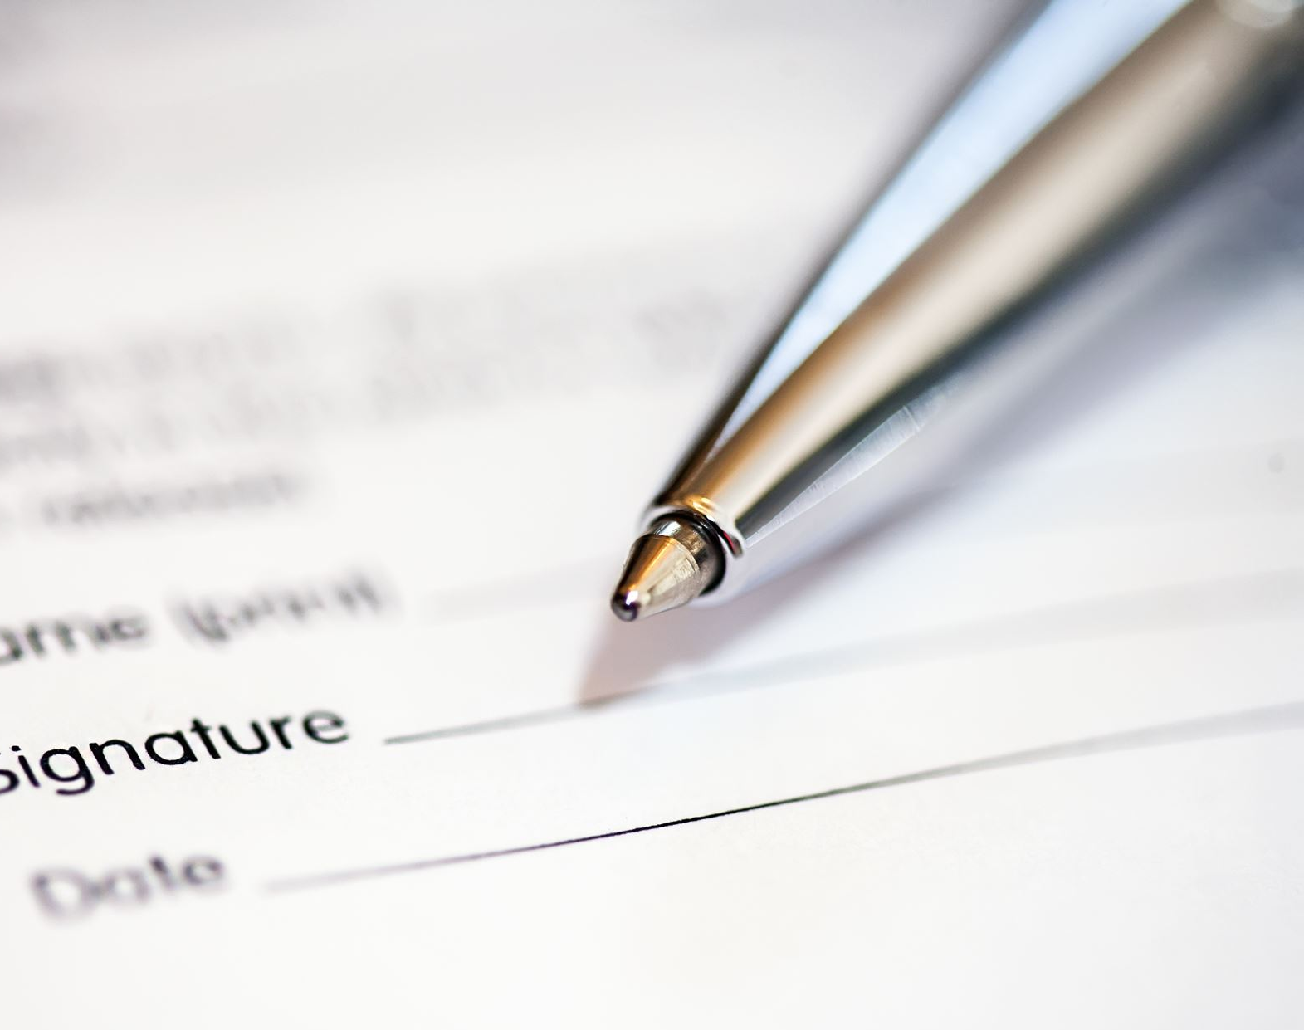
Kane County Clerk’s Office, Signature Verification
MANUAL VERIFICATION OF SIGNATURES ON VOTE BY MAIL ENVELOPES
BY: WARREN SPENCER, Certified Forensic Document and Fraud Examiner

Slide 2
Voting by Mail is easy but presents unique challenges. 1. The voter is not present when casting their Ballot. 2. Election Judges can not visually identify the voter and converse with them. 3. The signature on the Ballot Return Envelope is the only means to determine if the voter is actually the person casting the ballot. 4. Election Judges will be reviewing a high volume of signatures as VBM Ballots are processed.
Notes:
Voting By Mail is not a new concept. This has been around since the American Civil War for service men that could not make it to their home voting places. We have 160 years of precedence to guide us.
The pandemic motivated more and more people to take advantage of the convenience of sending in their voting choices by mail.
Because the person voting by mail is not standing before the Election Judges to pledge themselves, it is important that we take the time to validate the ballots that the voters mail into the election office. Every legitimate vote must have the opportunity to be counted.
Election Judges are your friends, neighbors, and family members and will make that determination based on what training and experience they receive about signature verification.

Slide 3
Important to build Public Trust
Technology has assisted in the election process. High speed equipment has been introduced to aid in efficiency and accuracy of the election process.
Scanners captures images of the signature. However it does not authenticate signatures. A bi-partisan team of trained Election Judges must view and authenticate each signature together.
Notes:
Signature verification is the process of confirming each voter’s identity by comparing the signature on their ballot return envelope with their voter registration record. This enhances the security and integrity of the mail ballot process.
When we apply consistent and efficient practices, our confidence in signature verification improves. We can be confident in the procedures confirming that ballots returned by mail are legitimate.
The ability to vote by mail will not be going away, therefore we are mastering signature validation to assure accuracy and authenticity.

Slide 4
Election Judges Course in Signature Authentication
Notes:
The Kane County Clerk’s Office has developed a course in signature authentication to provide consistency in determining the legitimacy of the signatures on the Vote by Mail ballot return envelopes. We will show you some of the principles taught to the team of Election Judges. In this presentation we will highlight an abbreviated version of a two and half hour class.

Slide 5
First, a brief Vocabulary lesson
We do not say “Forgery.” Forgery is a crime that consists of intent to defraud by misrepresentation. Only a judge in our court system can deem if this situation is a crime, and what someone else gains by this misrepresentation.
We can still make the handwriting inspection.
Instead of using the word “forgery”, we can determine if a signature is “Genuine” or “Authentic” and written by the person that owns that name. Or, we can determine the signature is “Suspect” or “Challenged” meaning that the owner of that name may not have created that signature.
Notes:
We must use proper terminology. We avoid using the word forgery as this is a legal issue determined in a court of law.
We prefer “Genuine” or “Authentic” or “Suspect” or “Challenged.

Slide 6
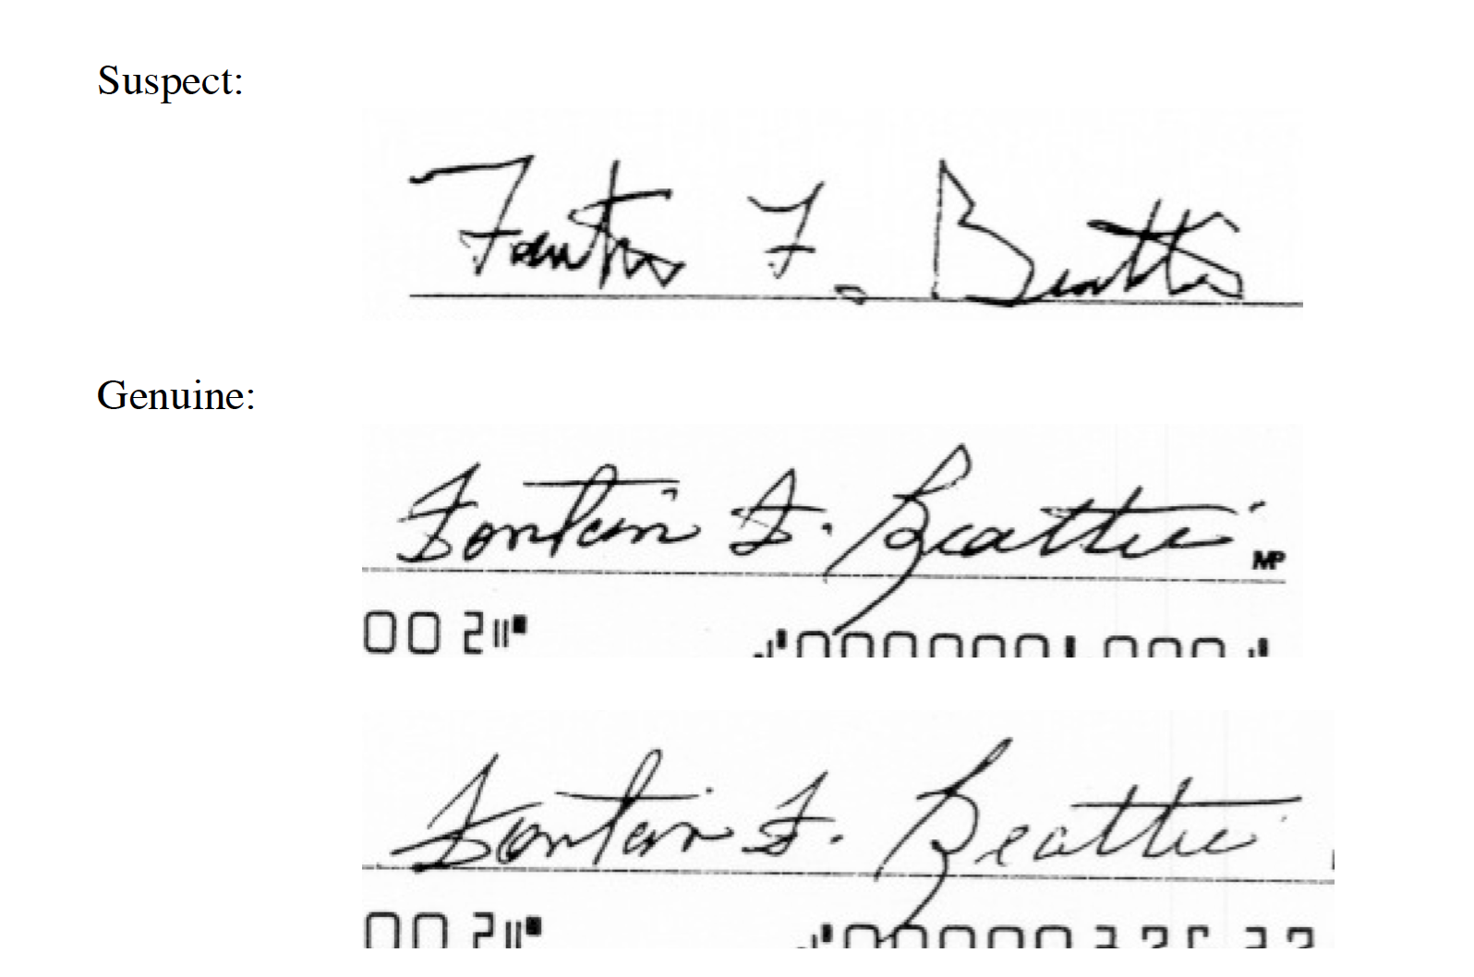
Natural Variance in Signatures
FACT: People do not sign their signature the same way every time.
Signatures change over time and in different settings. BUT the Basic Elements of their signature never changes
Suspect:
Notes:
With some signatures, you can see at a glance why the signature should be challenged.

Slide 7
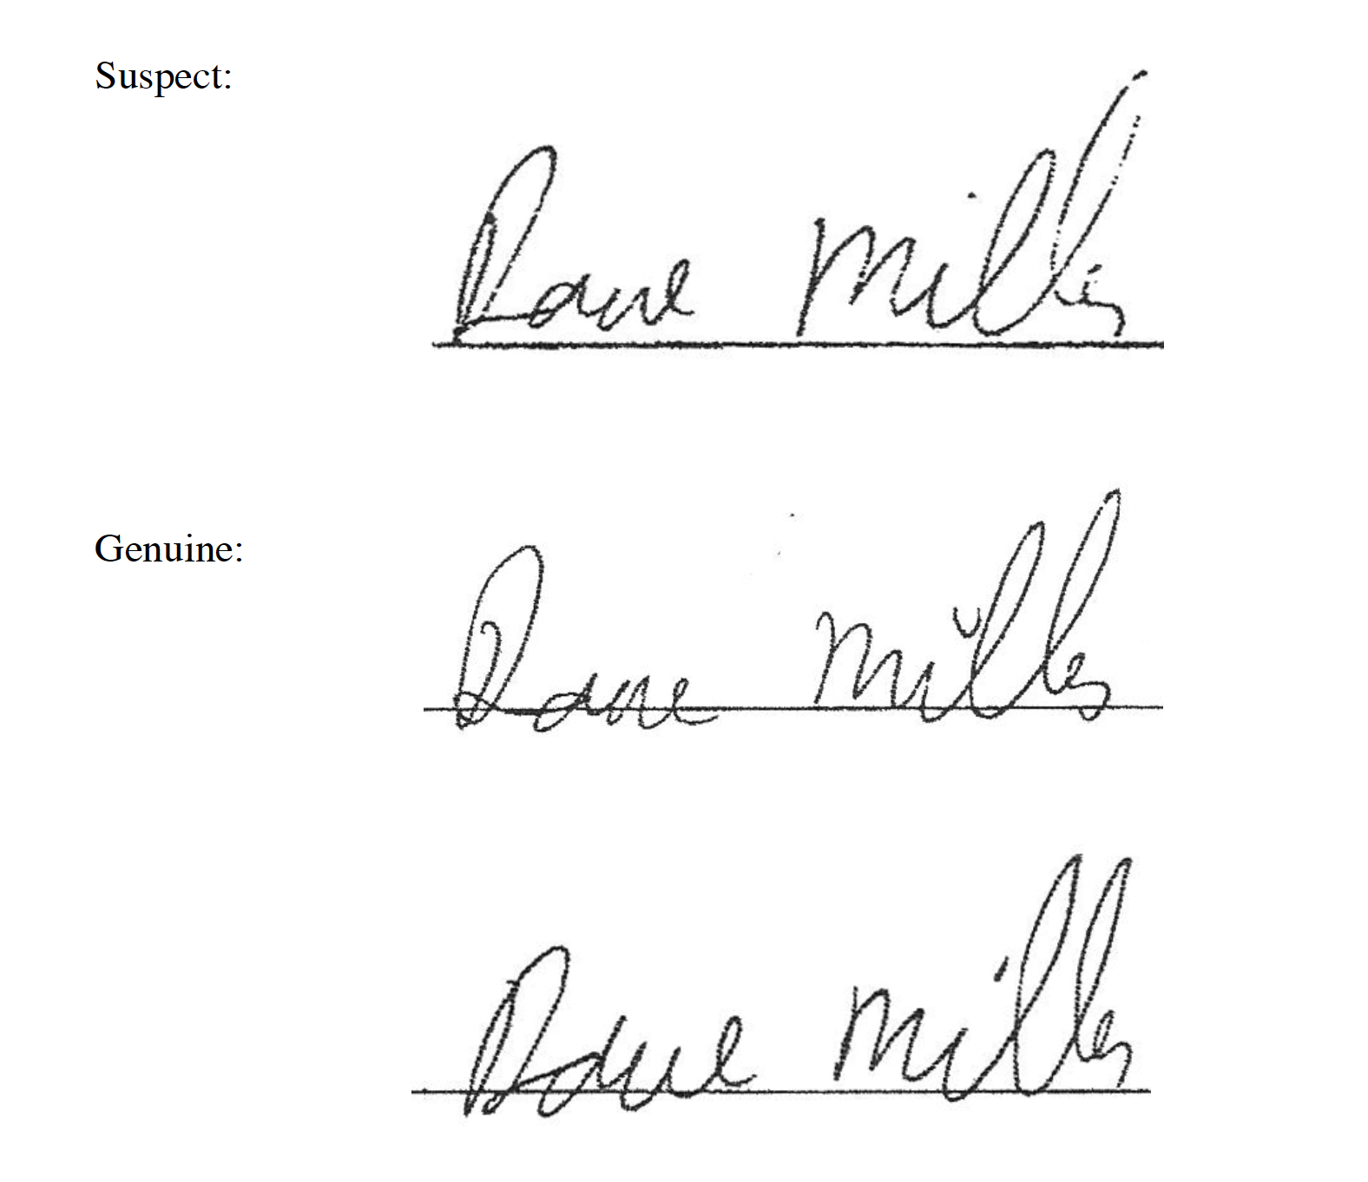
Notes:
Why do you think the top signature is suspected of not being genuine?

Slide 8
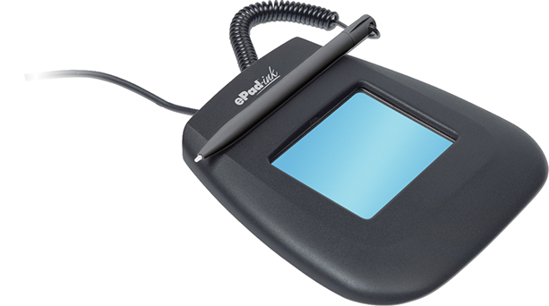
Compounding Issues with Signatures on Record
Today, voter registrations and Department of Motor Vehicles ask you to digitally sign your name with a stylus.
Some devices do not let you see your signature as you sign it, and that presents visual disturbances.
The digital Signature can be different from a wet ink on paper signature.
This presents difficulty in determining if a signature is genuine and sometimes results in challenged ballot submissions.
Notes:
Todays, voter registrations and the Department of Motor Vehicles has you digitally sign your name with a stylist. Some devices do not let you see your signature as you sign it, and that presents visual disturbances.
The digital Signature can be different from a wet ink on paper signature. We will be examining wet ink on the envelope signatures and will ask you to compare them to the digital signatures we have on file through the DMV.

Slide 9
The Signature Class Teaches
General Information about signatures
Principles and Theories about Signature Analysis
Various types of Forgeries
Signature Variables
Determining Authenticity:
Identifying Broad Characteristics
Identifying Local Characteristics
Notes:
The signature verification training teaches some basic principles that give the Election Judges an understanding of what to be mindful of when doing signature verification.

Slide 10
A signature is the most common thing a person writes in their lifetime.
You sign your name over and over, to the point it becomes largely a “habit.”
You don’t have to think about “Creating a Signature” as it is a remote discipline.
However, for as often as you sign your name, no two signatures are ever “Identical.” If they are, they are “copied” (forged signatures.)
There should always be very slight natural variations in each sample.
Still, the basics of the signature remain consistent.
Notes:
We start writing our names on papers from the time we entered school….our signatures become the single most combination of letters we tend to write in our lifetime.

Slide 11
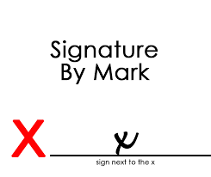
No Rules
There are no rules with respect to writing a signature, so they are open for being highly individualized.
In the state of Illinois, we accept:
printing,
cursive,
print-script
and “Marks”
However, this Signature or Mark or style must remain consistent with what is on file for the writer.
Notes:
There is no law that states signatures must be in cursive, or in print, or in a combination of the two. In fact, any “mark” made to identify an individual is acceptable by law. The only condition we have for evaluating signatures on election envelopes is that that “mark” or style of writing must be consistent with the image of the signature mark on file in the voters record in the Election Office. However we see very few signatures by mark.

Slide 12
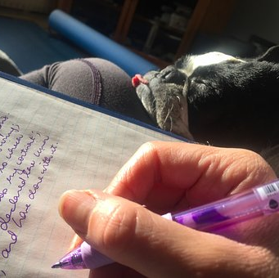
Everyone’s writing is Unique
Because everyone’s signature is personal and individualized, Signatures are identifiable and legally binding.
Notes:
Signatures are legally identifiable and binding.

Slide 13
Do Signatures Change?
Yes! Signatures do change over a lifetime.
Temporary changes may be due to an event (such as an auto accident, or assault, broken arm, etc.) or due to medical or chemical events in the body (alcohol, drugs).
Age does take its toll on the body, just as does extended health issue. Tremors, micrographia, and variable pressure are common in this instance.
Notes:
Signatures change over time for various reasons.
Micrographia is an acquired disorder that features abnormally small, cramped handwriting and the progression to smaller handwriting. It is commonly associated with Parkinson’s or other diseases that impact motor skills.

Slide 14
Factors that affect Handwriting:
#1 Physical Influences;
Age, Health, Injury, Fatigue, Chemicals
Hand/Eye Coordination
#2 Mechanical Influences;
Paper, Writing Instrument, Writing position
Writing Surface, Guided hand
#3 Psychological Influences;
Trauma, Anxiety, Duress
Notes:
Other things that influence handwriting and signatures:
Physical
Mechanical
Psychological

Slide 15
Principles and Theories
Genuine Signatures
Natural line quality, rhythm and movement
Beginning and Ending strokes are tapered
Smooth Letter Connections
Each segment of the signature flows naturally to the next
Notes:
Even the untrained eye can often spot genuine signatures.
We can readily see line quality and rhythm of movement.
Beginning and ending strokes tend to be consistent and are tapered.
Smooth letter connections and pen-lifts are easily spotted.
There is usually a natural flow between segments.

Slide 16
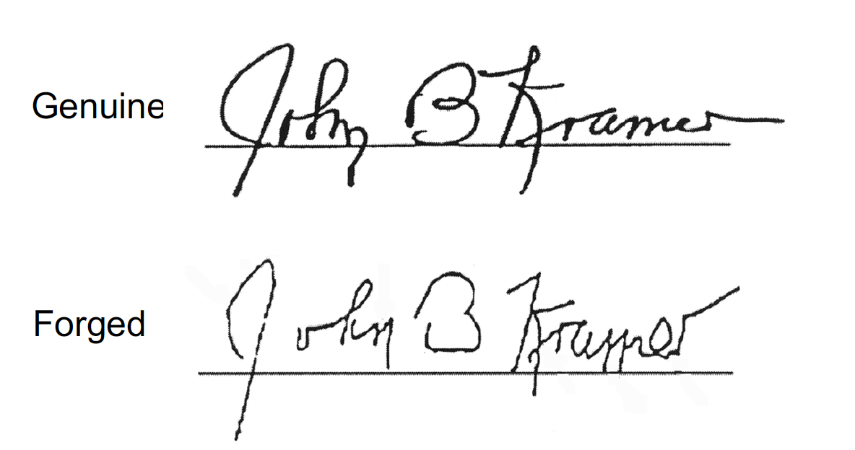
Principles and Theories
Non-Genuine Signatures
Disrupted line quality, rhythm & movement
Hesitant, jerky, shaky, “Drawn”
Blunt beginnings and ending strokes
Angles instead of rounded curves
Pen-lifts and or pauses between segments of signature
Notes:
Can you see the differences?
Disruptions in line quality, lack of rhythm of movement.
Jerky and hesitant by an attempt at “drawing” the signature.
Angles instead of rounded curves.
Pen-lifts and pauses between segments.

Slide 17
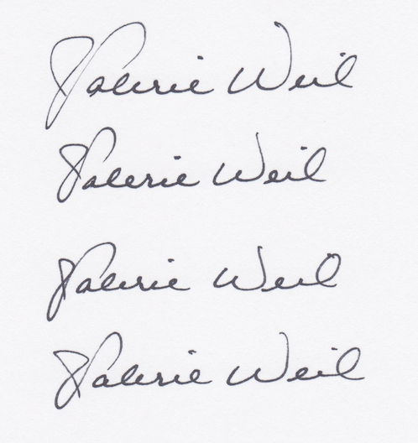
Principles and Theories
Signature Variables
Normal changes occur in everyone’s writing or signature.
Some variations within a person’s signature is one indication of “genuineness.”
Notes:
Some variations are expected in fact minor variation are one indication of the signature being genuine.

Slide 18
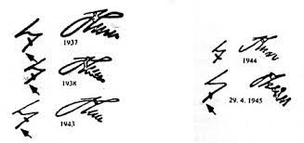
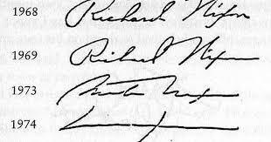
Principles and Theories
Signature Variables over Time
Notes:
Age, stress, and health issues can make a difference over a period of time.
The image on the left is Adolph Hitler’s and the image on the right is Richard Nixon’s they both show the effects of stress and in Hitler’s case drug abuse.
Normal variations may result in slight changes in letter construction, beginning or ending strokes, connections, size, etc.
Such variables do not alter the integrity of the signature as a whole.
So, even though there are variables, in most instances the signature will remain readily identifiable.

Slide 19
Principles and Theories
Pictorial Appearance of Signatures
The overall effect or “look” of the signature
The initial impression – the first to strike one’s eye
Making the signature immediately recognizable
Governed by size, slant, arrangement, spacing, degree of simplification or elaboration, etc.

Slide 20
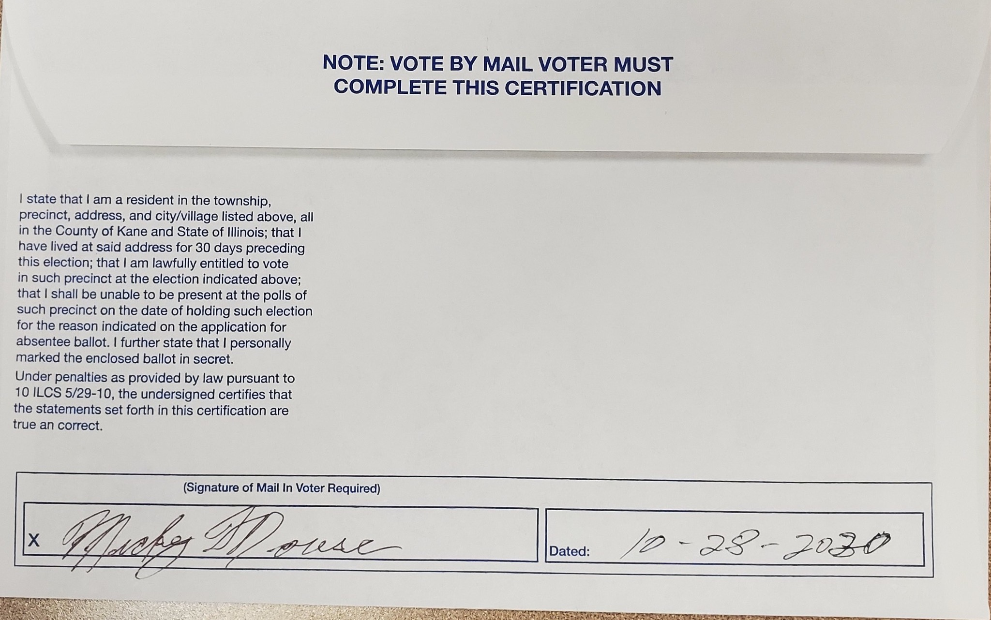
Simple Forgery
Types of Forged Signatures
“Simple Forgery” is just signing another’s name. There is no intent to imitate the authentic signature
Notes:
I know we don’t like the use of the term forgery but this is called simple forgery. There is no intent to imitate the signature or deceive.

Slide 21
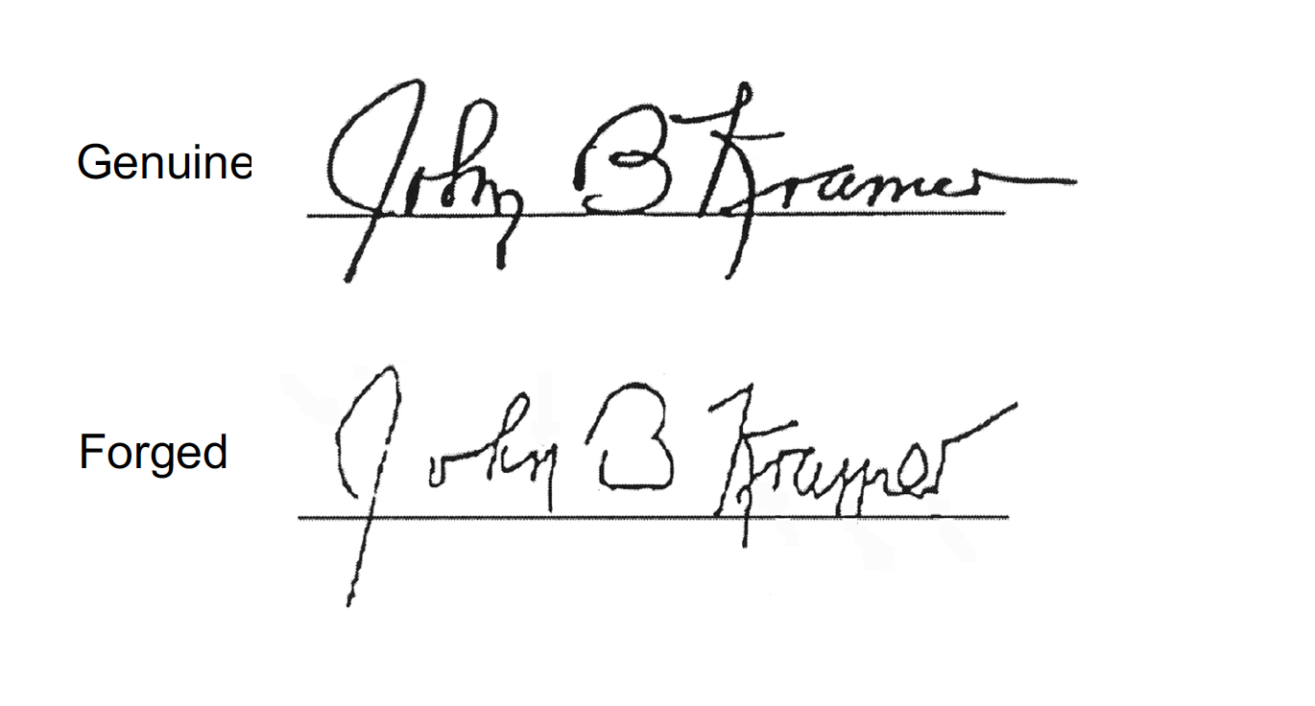
Simulation
Types of Forged Signatures
“Simulation” is making a free-hand imitation of a signature (essentially a drawing of someone else’s signature)
Notes:
Simulation is an attempt at freehand imitation or drawing a signature.

Slide 22
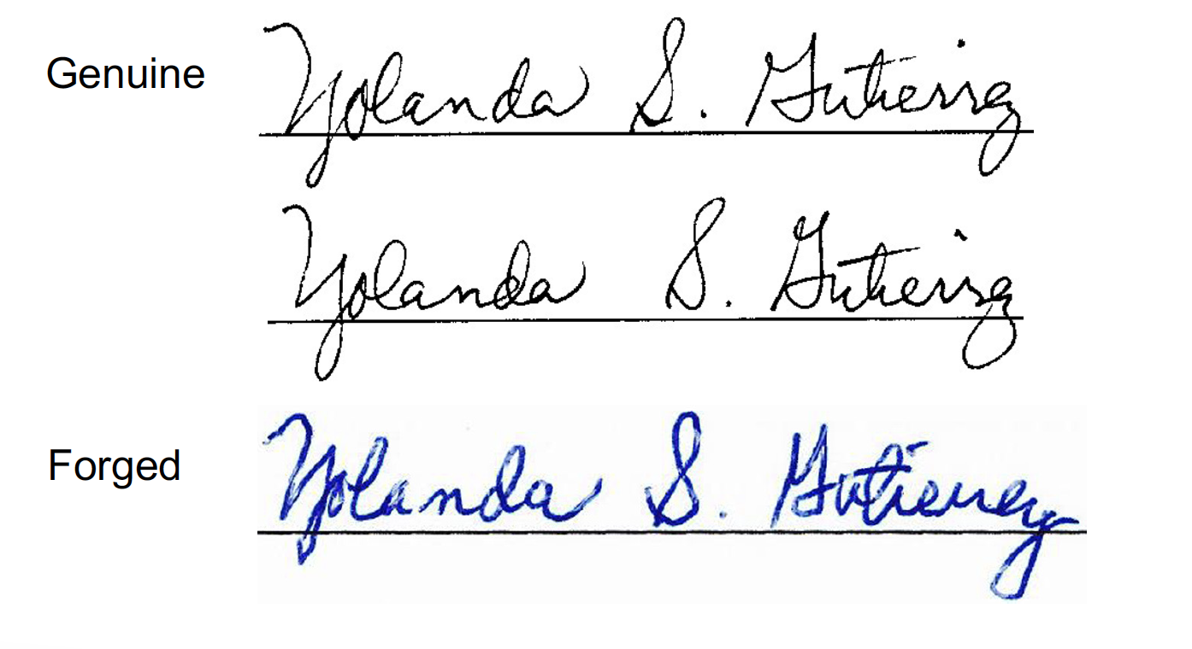
Transferred Signature
Types of Forged Signatures
This is the classic “Cut and Paste”. Some forgers actually cut and paste and then make photocopies to eliminate the edges of the paper; or a digital cut and paste from document to document.
Notes:
With todays technology it is easy to cut and paste a signature. Remember earlier we discussed some variations are normal in a genuine signature absolute duplications is a sign the signature may be suspect.

Slide 23
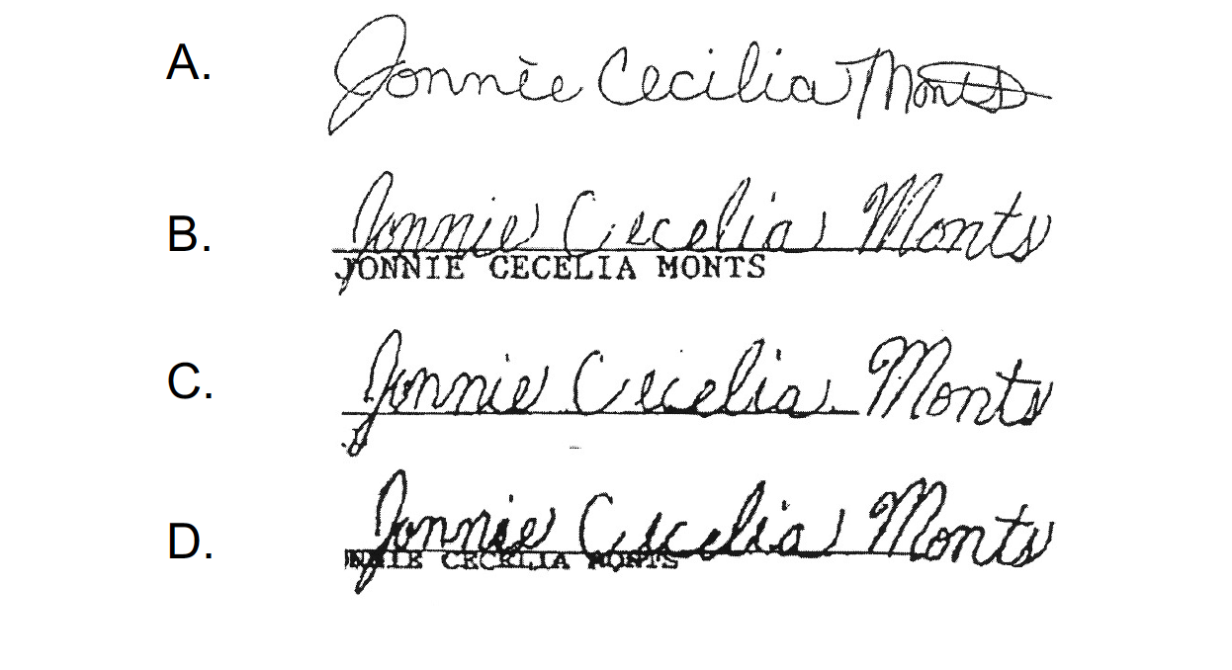
Traced Forgery
Types of Forged Signatures
“Traced Forgery” is using the original signature as a template and then they actually trace the signature.
Notes:
Traced Forgery is another method used. The top signature is genuine the others are traced. You can see the variations in line quality, pen-lifts and shakiness from lack of rhythm while tracing as well as differences in beginning and ending strokes.

Slide 24
To consider a signature as genuine:
There must be:
Significant agreement between the questioned and known signatures.
And, NO unexplainable differences.
Notes:
Just read from the slide

Slide 25
So, what is an “Explainable” difference:
There must be:
Significant agreement between the questioned and known signatures.
And, NO unexplainable differences.
Age
Medication
Injury or Illness
Recent Trauma
Guided Hand
Notes:
Since we do not have access to this information, a signature can be denied. It would be up to the writer to do the explaining of why there is a significant change in their signature.
It is acceptable to challenge the signature in these cases.
Not your circus, not your monkey.

Slide 26
To consider a signature NOT Genuine
There must be:
Differences in the nuances of the questioned and known signature not otherwise explained, and/or
Structural differences between the questioned and known signatures.
Caution:
Consider whether you have examined sufficient exemplars to establish the writers usual patterns of variation
Genuineness and perfection are not the same
Notes:
So we have learned that there must be unexplainable differences in the structure and flow if signature to be challenged.
Genuiness and perfection are not the same.
We are not attempting to make our VBM Election judges experts in signature verification or handwriting analysis but we want them to be aware of things to look for when reviewing signatures.

Slide 27
Broad Characteristics Print vs. Cursive Alignment Capital Letters Spelling Slant Proportions Speed Size
How to Make A Determination
Local Characteristics Word Spacing Letter Spacing Garlands Arcades Stroke Angles Stroke Threads Curves Pen Lifts Beginning Strokes
Ending Strokes Line Quality
Notes:
Election Judges performing signature verification of Vote by Mail Ballots are trained to look for characteristics present in signatures on ballot envelops in comparison to the voters signature of record on source documents. The signature verification course does a deeper dive in each of the characteristics. If you would like to learn more I would encourage you to sign up as an election judge. There is a video course on Signature Verification that is available to all election judges.

